Slide 1

American Families
Professor Meyer

Slide 2
Listening Exercises
P. 15 #3, 6
P. 23 #3
P. 16 #7-8

Slide 3
Quiz
Sally gets embarrassed easily. (True or False)
Jake loves the rain. (True of False)
Correct Answers
True
False

Slide 4
Culture: Shared set of values
Examples of Chinese values
  Respect for parents
  Respect for elders
  Respect for authority
  Nationalism: love of country
  Importance of guanxi
What do you think are American values?

Slide 5
What is individualism?

Slide 6

Ideal American individualist
Bill Gates or Steve Jobs
Overcome adversity
Individualistic social skills
Accomplishments

Slide 7
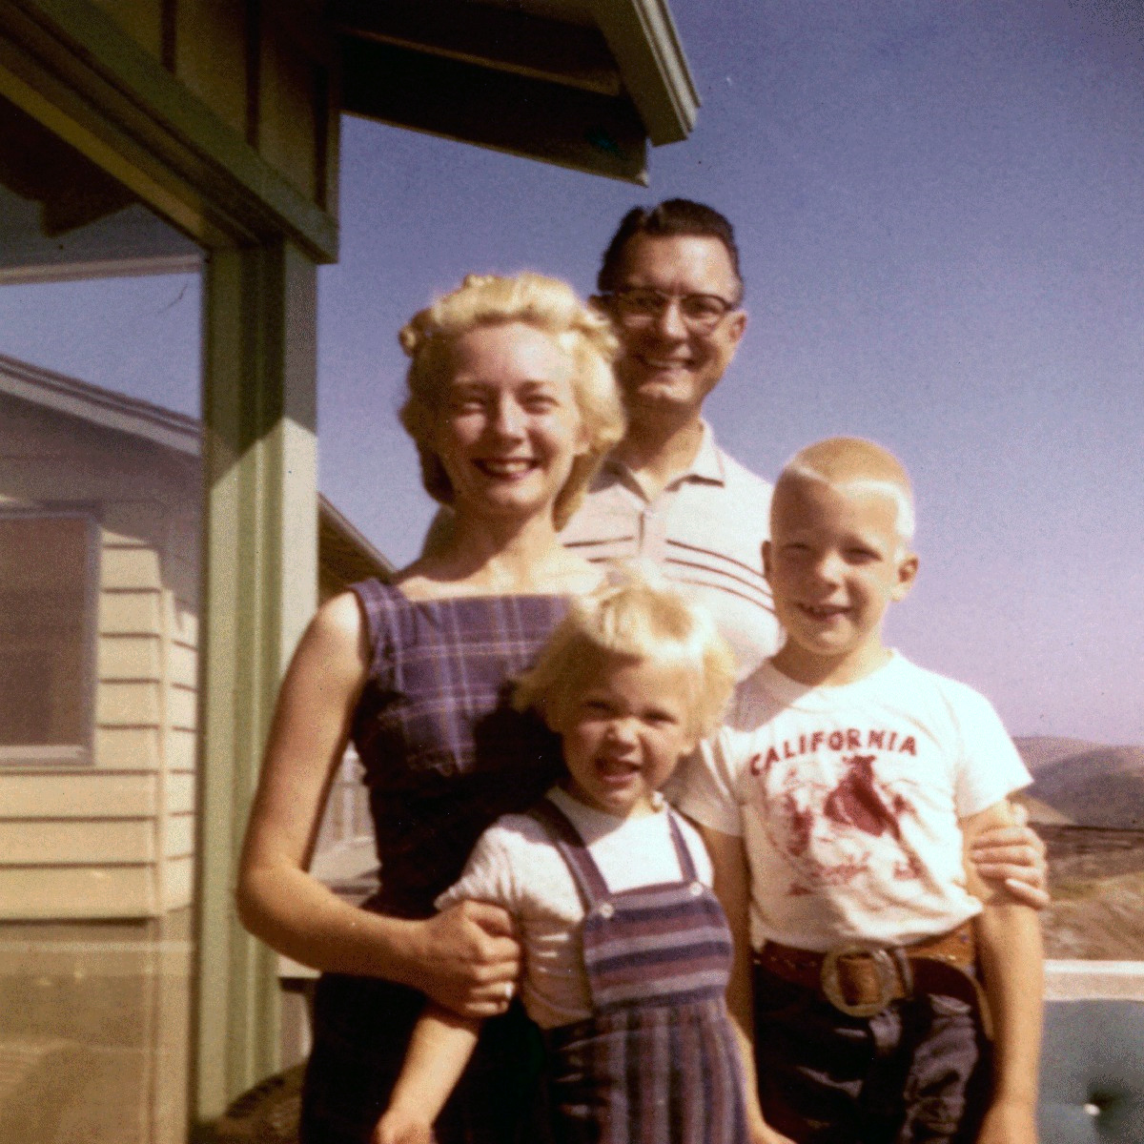
The American Nuclear Family
Notes:
nuclear family
relatives.
for most Americans, the family has tradi- tionally been a small group of people, not an extended network.

Slide 8

Alternative American Families
Notes:
Househusbands” or “stay-at- home dads”
“blended families”
“alternative families,”
Since international adoptions began in China, our adoptions unit has issued over 70,000 immigrant visas to Chinese orphans adopted by American citizens.
星期一

Slide 9
Individualism in Parenting
Children’s opinions have strong influence
“Well rounded” children
  Too much homework
Babysitters
Positive guidance instead of punishment
Children have their own room
Mind your own business
Notes:
strollers
lbeaskedfor their opinions and will express opinions even without being asked.
Children of any age may interrupt their parents, argue with them,
make demands of them, or loudly express their disapproval of parental
decisions they dislike.
larger than necessary. cribs
,childrenhavetheirownbedrooms,
share responsibility for—childcare, cooking, washing clothes, or doing other household chores.
Electricappliancesandelectronicentertainmentdevices(
ental care (straight teeth seem extremely important); medical care for any perceived defect; a preschool (where in some cases very young children are encouraged to learn to read); lessons for learning to draw, play a sport, dance, sing, or play a musical instrument; and perhaps counseling to help overcome emotional difficulties.
Academic achievement gets less emphasis from the average American family than it does from families in many other, particularly Asian, countries. American parents will complain if their children are given “too much homework”
Americans generally believe that parents “need some time away from the children” and often arrange for someone to babysit so they themselves can go out.
Many experts emphasize “positive guidance,” which means giving the child positive reinforcement when she behaves in a way that the parents like rather than punishing her when she does something the parents

Slide 10

Rebellious Teenager

Slide 11

Working Teenager

Slide 12

Peer Pressure

Slide 13

Empty-Nest Syndrome

Slide 14

Mid-Life Crisis

Slide 15

Senior Citizens, Snowbirds, and Nursing Homes

Slide 16

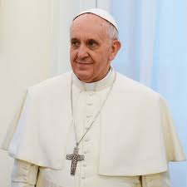

Christianity (Christians)
Protestantism (Protestants)
Catholicism (Catholic)
The Bible: Jesus Christ is the son of God

Slide 17


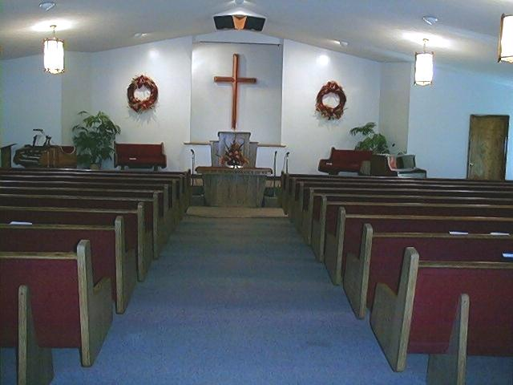


Slide 18


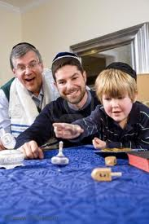

Judaism (Jew)
Torah: Jesus is a prophet
Synagogue
Yamaka
Star of David
Hebrew

Slide 19

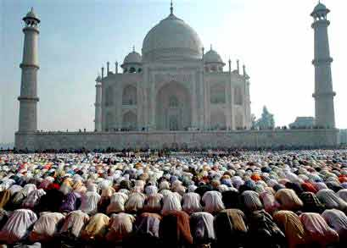
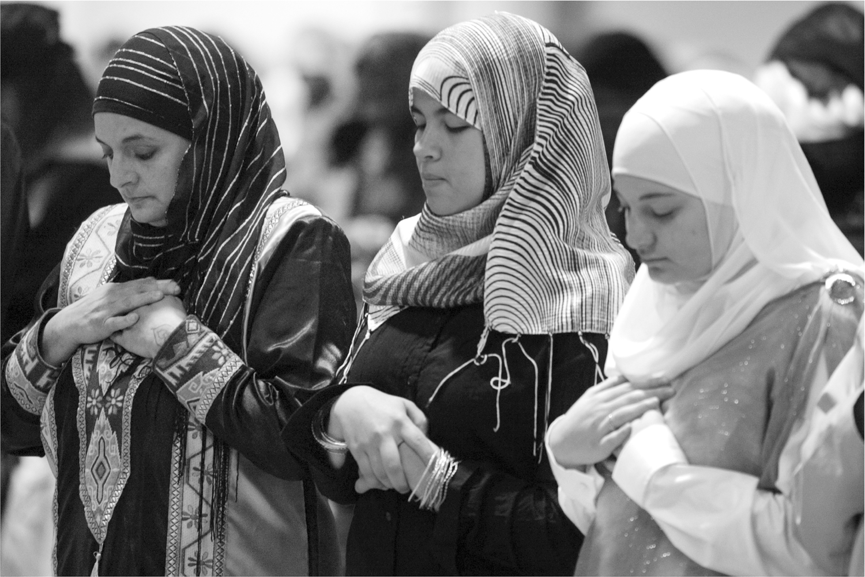
Islam (Muslim)
Qur’an: Prophet Mohammed
Ramadan
Mosque
Hijab/Burqa

Slide 20
Other religions
Mormonism (Mormon)
  Book of Mormon: Joseph Smith
Agnosticism (Agnostic)
  Maybe there is a God, but I don’t care
Atheism (Atheist)
  There is no God
  Belief in science and fact

Slide 21
Telling a Story About Your Family
Set the scene
  When I was younger…
  A lot time ago…
Introducing a sudden event
  All of a sudden, …
  Suddenly, …
Creating suspense
Sounding dramatic
Looking back
  It was the most (adjective) day of my life!
  I felt on top of the world.

Slide 22
Homework
Unit 2
  P. 20 #2, 4
  P. 21 #7-8

Slide 23
Resources
Host Families in the USA:
http://china.international-experience.net
Culture differences between China and the USA:
http://www.china-nafsa.aief-usa.org/culture/differences.htm
Adoption Statistics:
http://adoption.state.gov/about_us/statistics.php

